Slide 1
About Florida Green
Bird-Safe Design Features Earn Innovation Points Towards FGBC Certifications
Overview
C. J. Davila
Executive Director
Florida Green Building Coalition
Notes:
First, What WE do.
Then, what YOU can do.

Slide 2
About Florida Green
With over 30,000 certifications to date, FGBC is by far the largest certifier of green homes, communities and local governments in Florida.
Florida Green are the only standards developed with state-specific criteria. They address Florida’s hot-humid climate, environment, topography, resiliency and natural disasters.
Notes:
First, What WE do.
Then, what YOU can do.

Slide 3
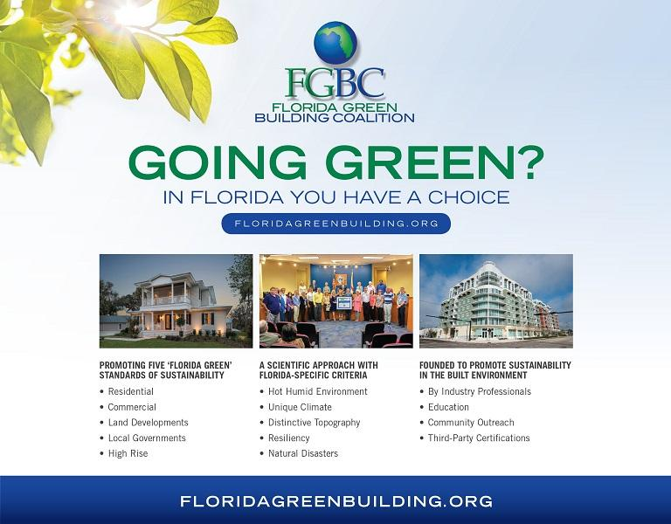
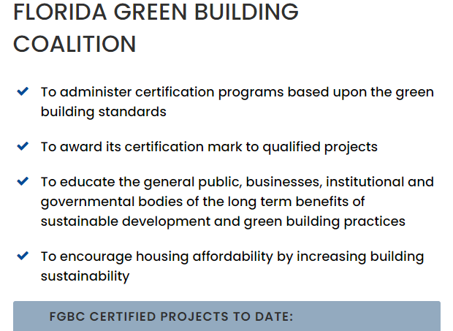
About Florida Green
Florida Green Building Coalition
222 2nd Street North
St. Petersburg, FL 33701
407-777-4914
info@floridagreenbuilding.org
www.floridagreenbuilding.org
30,217
Notes:
First, What WE do.
Then, what YOU can do.

Slide 4
FGBC’s Florida Green Certification
FGBC Has Developed 5 Standards
Homes
Developments
Local
Government
Cities/Counties
Commercial
High Rise
Residential

Slide 5
Certification Process

Slide 6
How Certification works?

Slide 7
Bird-Strike Mortality
Every year nearly one billion birds
fatally collide with glass in the U.S.
56% of collision mortality occurs at
low-rise buildings 1-4 stories
44% at urban and rural residences
Less than 1% at high-rise buildings
Bird populations in North America have declined by 3 billion birds in the last 50 years
Notes:
First, What WE do.
Then, what YOU can do.

Slide 8
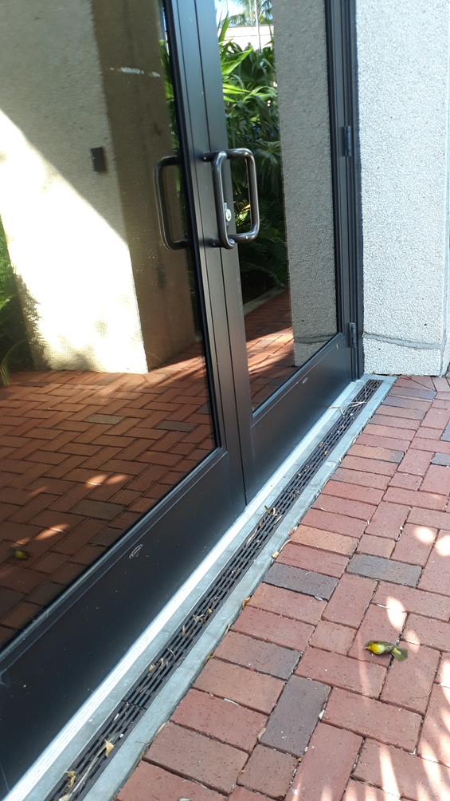
Bird-Strike Causes
Birds do not see clear or reflective glass as a barrier
Glass creates a lethal illusion of clear airspace
Majority of collisions occur during the day
due to reflections of landscape or sky
Lighted facilities cause confusion, especially
during inclement weather and migration periods
Notes:
First, What WE do.
Then, what YOU can do.

Slide 9
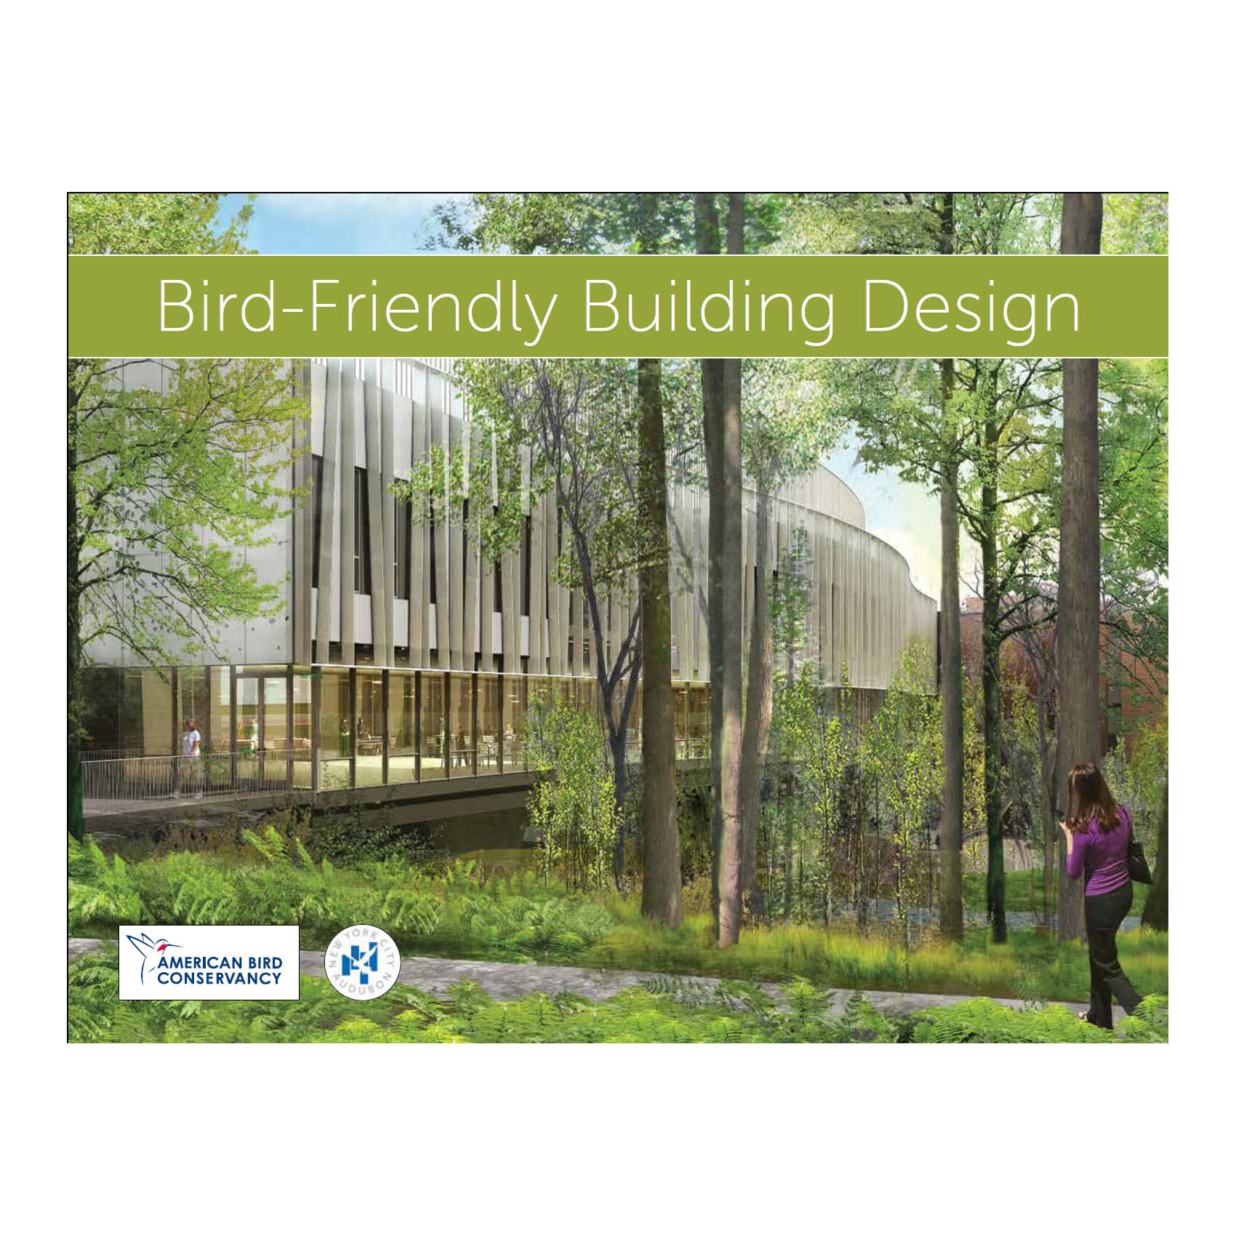
Bird-Safe Solutions
Building Design Features
Designing a building to be bird-safe may not require higher costs, especially if bird-safe measures are integrated early in the design process. Energy conservation measures often overlap with bird-safe measures, thereby enhancing the cost effectiveness of bird conservation.
Notes:
First, What WE do.
Then, what YOU can do.

Slide 10
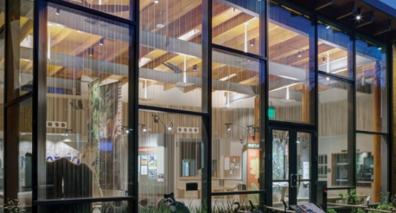
Glass Types
A variety of glass and window types are available to create visual barriers for birds reducing mortality from collisions.
Acid-etched, fritted or frosted glass
Ultraviolet Patterned Glass
Notes:
First, What WE do.
Then, what YOU can do.

Slide 11
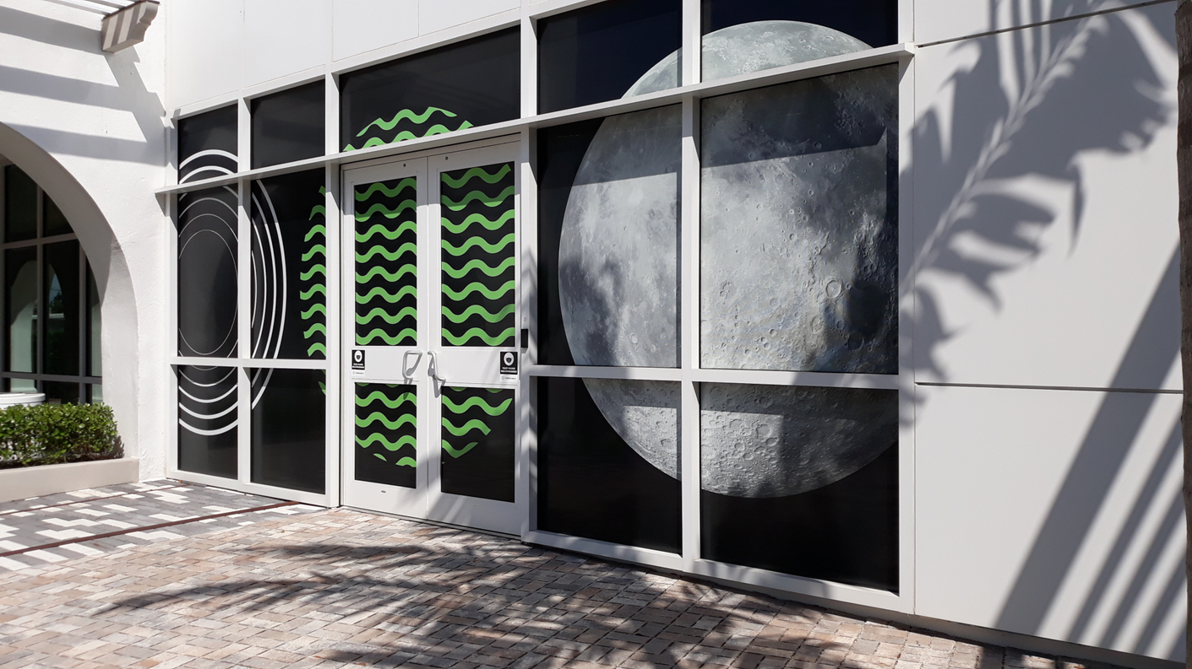
Building Design Features
Building designers can use features such as awnings, lattice-work, mesh and other creative strategies to reduce visibility into transparent areas.
Decorative film installed post-construction enables birds to perceive the glass as a sold object without blocking the view from the building interior. Micro-dot films range from virtually invisible to patterned.
Notes:
First, What WE do.
Then, what YOU can do.

Slide 12
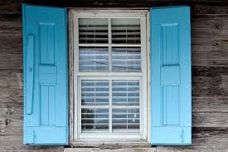
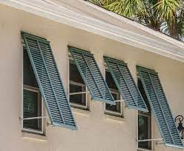
Awnings, Shades, and Shutters
Shaded windows allow building occupants access to outdoor views but reduce the glass reflections confusing to birds .
Using shutters is not a solution for every window. The most effective solution is to treat the exterior of the glass as well.
Notes:
First, What WE do.
Then, what YOU can do.

Slide 13
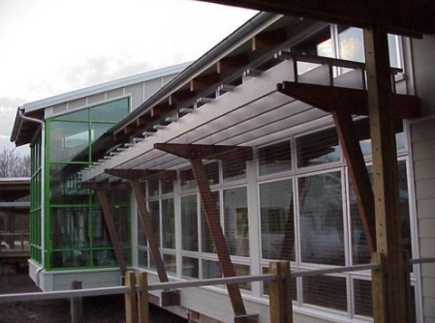
Screens and Netting
External insect screens or netting on windows is an effective and relatively inexpensive treatment to reduce the visual reflection and also provide a cushion between the bird and window.
Netting installed on slanted wooden beams. Photo by USFWS.
Notes:
First, What WE do.
Then, what YOU can do.

Slide 14
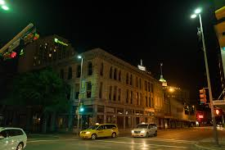
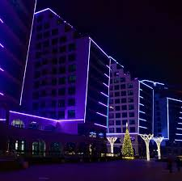
Nighttime Lighting
Not only is the elimination or reduction of unnecessary lighting one of the easiest ways to reduce collisions, it also saves energy and reduces costs.
Notes:
First, What WE do.
Then, what YOU can do.

Slide 15
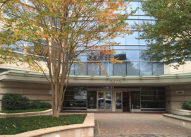
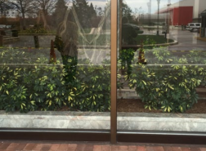
Vegetation, Landscaping and Outdoor Facilities
Where vegetation is adjacent to, visible through, or reflected in glass structures, treat the exterior of existing glass or install a bird-safe glass that is visible to birds.
Photos by USFWS.
Notes:
First, What WE do.
Then, what YOU can do.

Slide 16
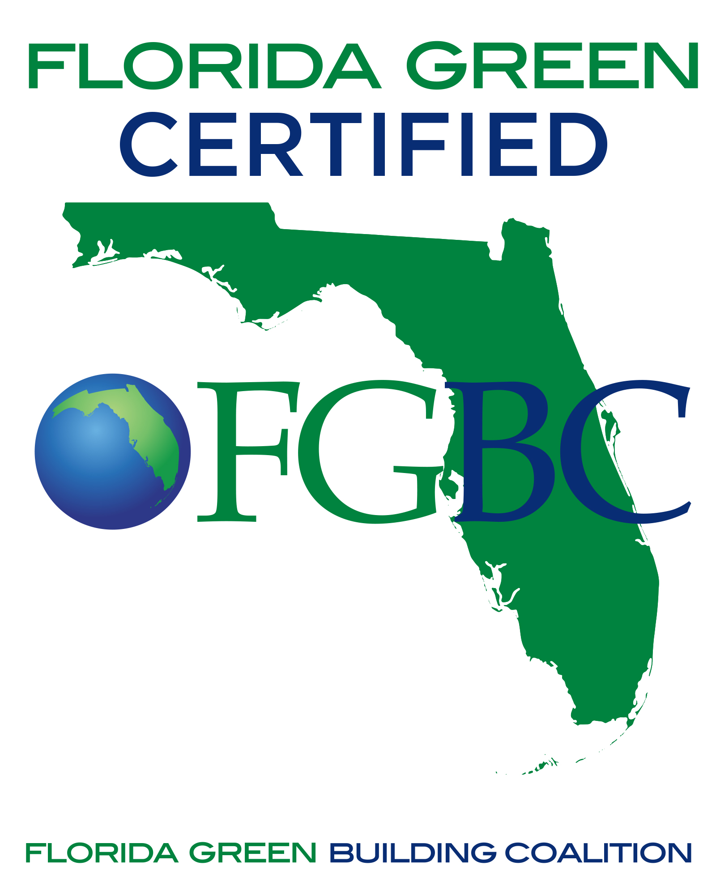
About Florida Green
Bird-Safe Design Features Earn Innovation Points Towards FGBC Certifications
Bird-Safe Design features approved
Points awarded in all 5 FGBC Standards
Claim points in Innovation tab
Duplicate points may be claimed for Bird-Safe Intent
Notes:
First, What WE do.
Then, what YOU can do.

Slide 17
Resources
Thank you to the U.S. Fish & Wildlife Services as well as Audubon of Southwest Florida. Additional information and links are below.
The American Bird Conservancy’s webpage (https://abcbirds.org/get-involved/birdsmart-glass/#1) includes a list of recommendations for ultraviolet patterned glass products.
For more information on screens and netting treatments can be used on new construction, renovations, and retro-fits. https://www.birdscreen.com
For more information on how reducing nighttime lighting can save many birds. see: https://www.audubon.org/conservation/project/lights-out
For more information on tape and bird window decals: https://abcbirds.org/glass-collisions/products-database/
Notes:
First, What WE do.
Then, what YOU can do.

Slide 18
For More Information
Call: (407) 777-4914
Email: info@floridagreenbuilding.org
Visit: www.FloridaGreenBuilding.org
Notes:
Please check out our web site for more information and for an application to join the Coalition.

